Slide 1


GIT Assignment
Presented By : Rishi Kumar Ray

Slide 2
Content
Introduction to GIT
Performing a commit
GIT WorkTree
Conclusion

Slide 3
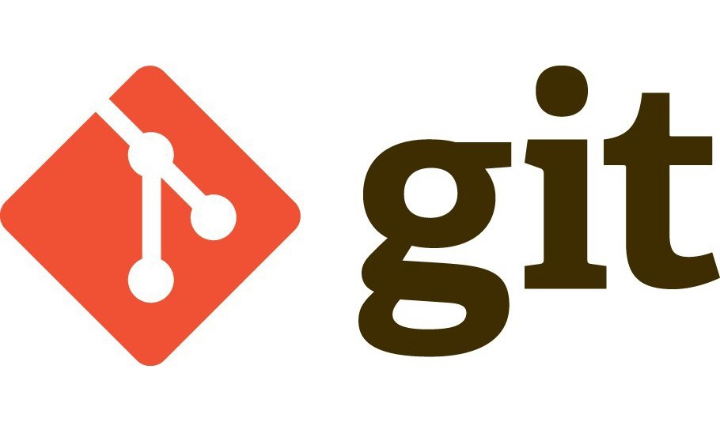
What is GIT?
Git is a free and open source distributed version control system designed to handle everything from small to very large projects with speed and efficiency. It was developed in 2005 by Linus Torvalds, the famous creator of the Linux operating system kernel. Git helps keep track of changes made to a code. If at any point during coding you hit a fatal error and don’t know what’s causing it, Git allows you to revert back to a stable state. It also helps you see what changes have been made to the code over time.

Slide 4
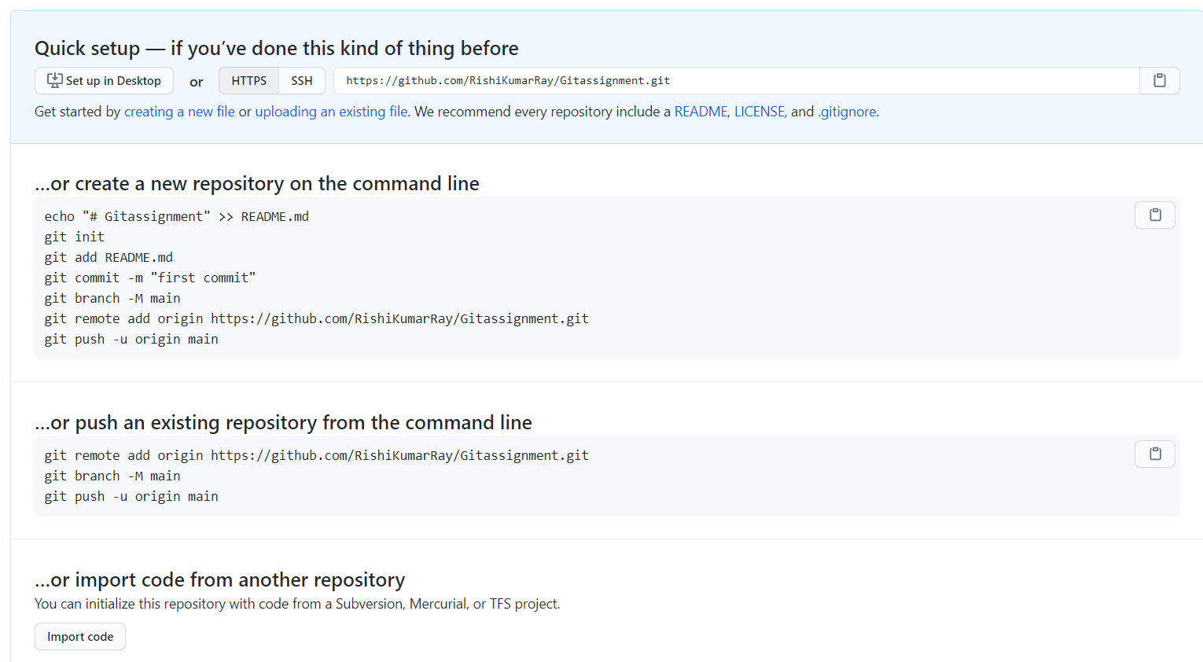
Creating a empty repository on Github
You have a dream?

Slide 5
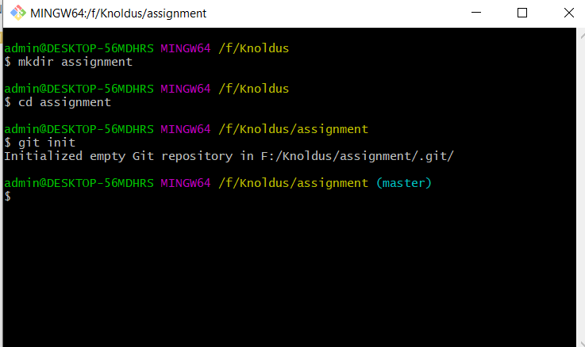


Creating a Directory and initializing a empty repository

Slide 6
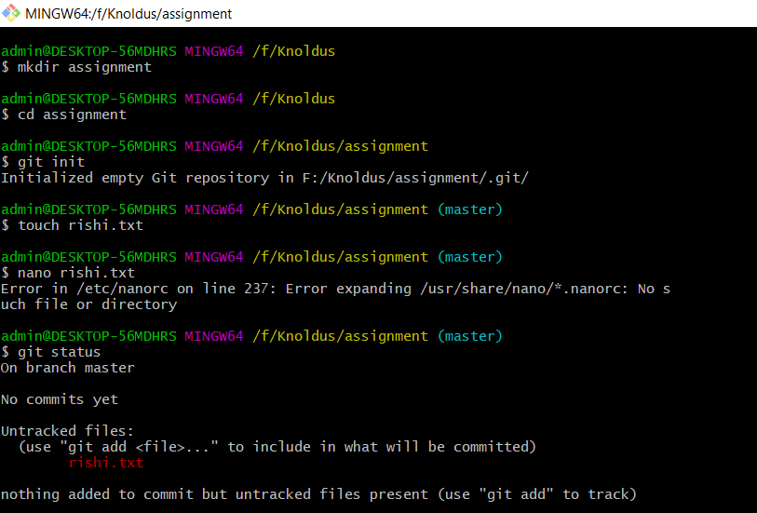
making a text file with touch and editing that with nano command

Slide 7
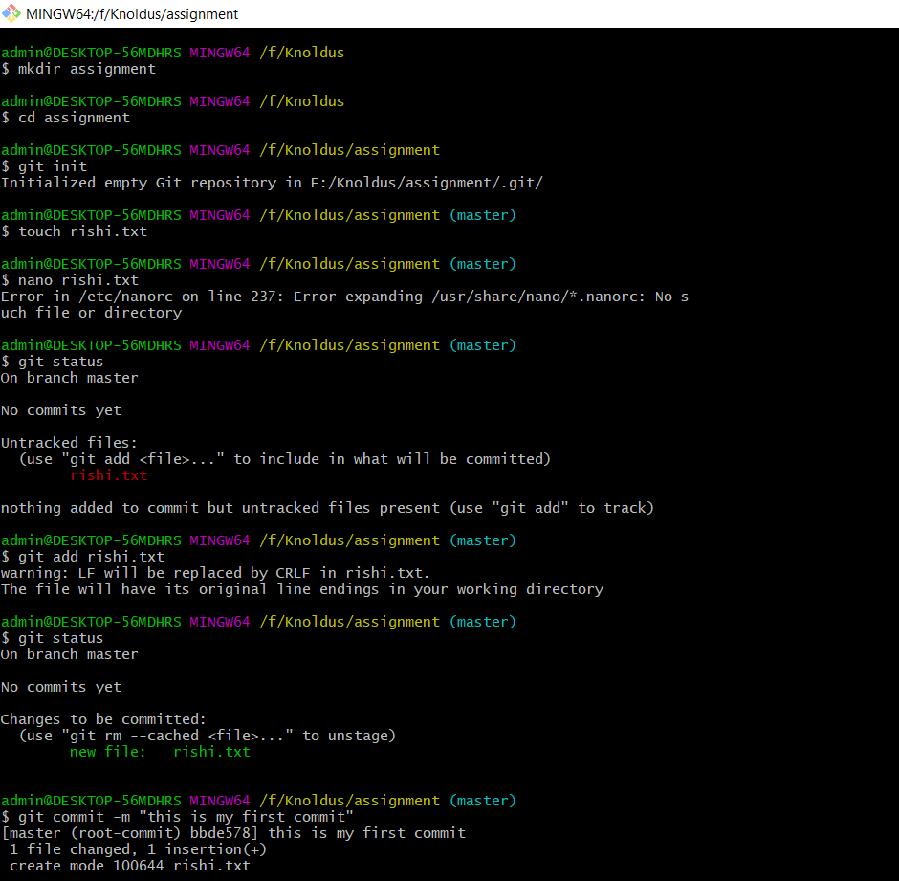
Since the file is now in untracked state we will first track and then perform commit

Slide 8
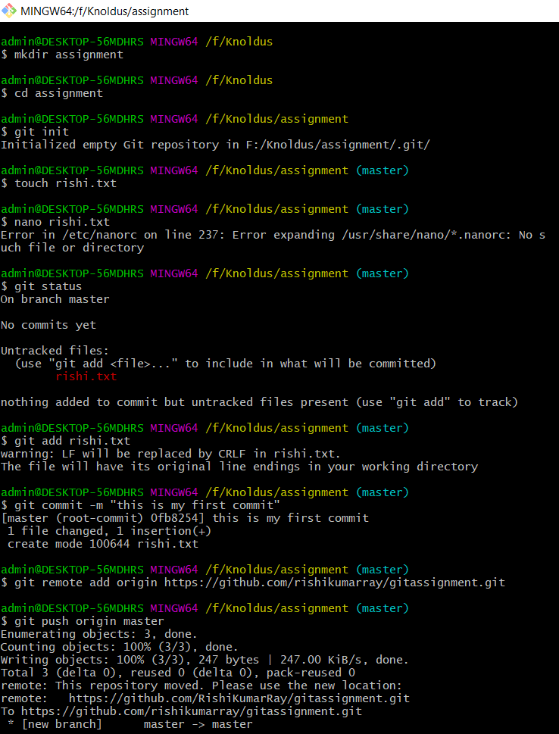
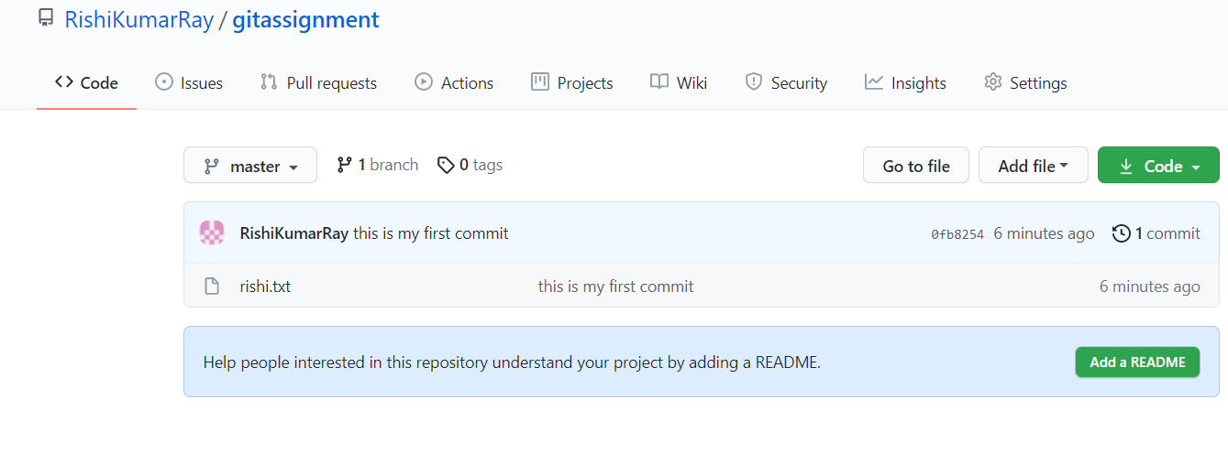
Now we will push this to our remote repository

Slide 9
GIT - Work Tree
A Git worktree is a linked copy of your Git repository, allowing you to have multiple branches checked out at a time. A worktree has a separate path from your main working copy, but it can be in a different state and on a different branch. The advantage of a new worktree in Git is that you can make a change unrelated to your current task, commit the change, and then merge it at a later date, all without disturbing your current work environment.

Slide 10

GIT - Worktree
git worktree add [-f] [--detach] [--checkout] [--lock] [-b <new-branch>] <path> [<commit-ish>]
git worktree list [--porcelain]
git worktree lock [--reason <string>] <worktree>
git worktree move <worktree> <new-path>
git worktree prune [-n] [-v] [--expire <expire>]
git worktree remove [-f] <worktree>
git worktree repair [<path>…​]
git worktree unlock <worktree>

Slide 11
Let’s understand the Uses of these Functions
Git Worktree add - It is used to create new directory called which is linked to your main project repository.
Git Worktree List - List details of each working tree.
Git Worktree Lock - It is used to lock it to prevent its administrative files from being pruned automatically.
Git Worktree Move - Move a working tree to a new location.
Git Worktree Prune - To ensure your .git directory is clean, use the prune after removing a worktree.
Git Worktree Remove - remove a working tree.
Git Worktree repair - Repair working tree administrative files, if corrupted or outdated due to external factors.
Git Worktree Unlock - Unlock a working tree, allowing it to be pruned, moved or deleted.

Slide 12
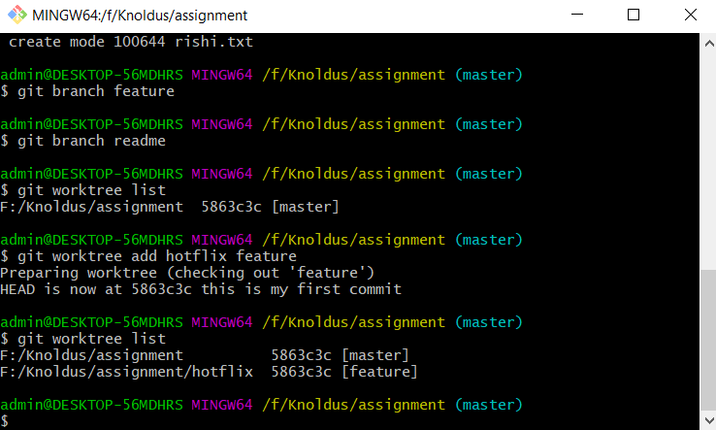
Performing these Commands
Here we used worktree
add command to create a new worktree.
Here we used git worktree list to see the total worktrees present

Slide 13
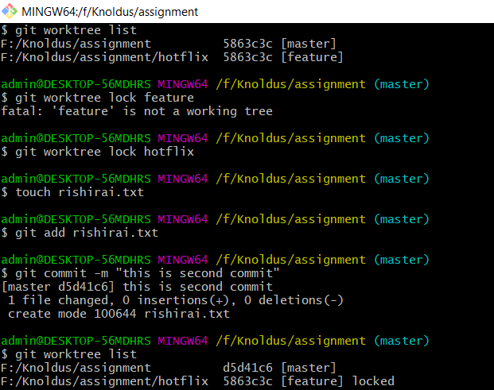
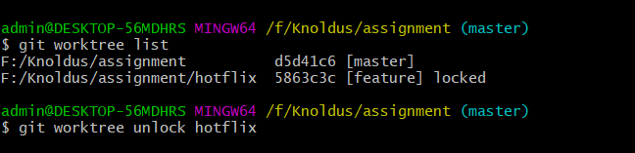


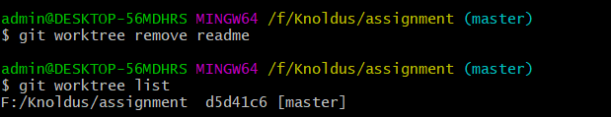
With git worktree lock we can lock to prevent administrative changes
Here we can see when we list the worktree it shows hotflix as locked, with unlock command we can unlock the git worktree.
Here we made the use of git worktree move command where we moved from hotflix to readme.
Here as we see after using git worktree remove, the readme is no more present in worktree lists.

Slide 14
My Github ID
https://github.com/RishiKumarRay/gitassignment

Slide 15
Thank You!

